Slide 1


<Insert Picture Here>
21 Best Practices and Exadata

Slide 2
Exadata
What is Exadata ?
Exadata Configurations
Key innovations
Exadata and Spatial data

Slide 3
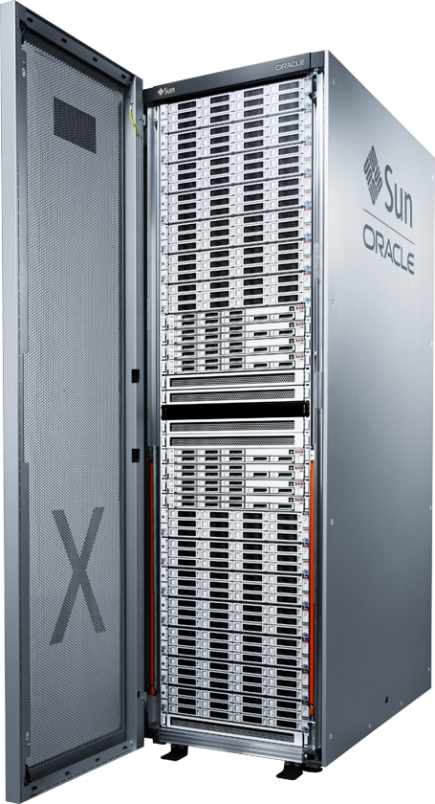
Exadata Database Machine A complete system - compute, storage, networking
Database Grid
Intel-based database servers
Oracle Linux or Solaris
Oracle Database
10 Gig Ethernet (to data center)
Storage Grid
Intel-based storage servers
Up to 672 terabytes raw disk
Up to 44 terabytes Flash storage
Exadata Storage Server Software
InfiniBand Network
Internal connectivity (40 Gb/sec)

Slide 4
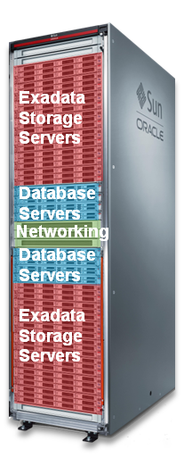
Exadata X4 Hardware Architecture
Database Grid
8 Database Servers
192 Xeon cores (50% more than X3)
Up to 4 TB of memory
Intelligent Storage Grid
14 High-performance low-cost storage servers
200 TB High Performance disk (100% more than X3) or 672 TB High Capacity disk (33% more than X3)
44.8 TB PCI Flash (100% more than X3)
Intelligent Storage Server Software
InfiniBand Network
2 x 36-port 40Gb/s switches
Unified server & storage network

Slide 5
X4-2 Database Server
New 12-core “IvyBridge” CPUs, Faster InfiniBand Card, Larger Disks
Processors | 2 Twelve-Core Intel® Xeon® E5-2697 v2 Processors (2.7GHz)
Memory | 256 GB (16 x 16GB) – Expandable to 512GB (16 X 32GB) via memory kits
Local Disks | 4 x 600GB 10K RPM SAS Disks (Hot-Swappable)
Disk Controller | Disk Controller HBA with 512MB Cache – Battery Online Replaceable
Network | 2 x InfiniBand 4X QDR (40Gb/s) Ports (PCIe 3.0) – Both Ports Active 4 x 1GbE/10GbE Base-T Ethernet Ports 2 x 10GbE Ethernet SFP+ Ports (1 Dual-port 10GbE PCIe 2.0 network card based on the Intel 82599 10GbE Controller technology)
Remote Management | 1 Ethernet port (ILOM)
Power Supplies | Redundant Hot-Swappable power supplies and fans

Slide 6
X4-2 Storage Server
6-core IvyBridge CPUs, Larger disks, Larger Flash Cards, Flash Compression
Processors | 2 Six-Core Intel® Xeon® E5-2630 v2 Processors (2.6 GHz) - Faster clock
Memory | 96 GB (4 x 8GB + 4 x 16GB) - More memory needed to manage larger flash
Disks | 12 x 1.2 TB 10K RPM High Performance SAS (hot-swap) – 2.5” disk size OR 12 x 4 TB 7.2K RPM High Capacity SAS (hot-swap) – 3.5” disk size
Flash | 4 x 800 GB Sun Flash Accelerator F80 PCIe Cards – Hardware Compression
Disk Controller | Disk Controller HBA with 512MB Cache - Battery Online Replaceable
Network | 2 InfiniBand 4X QDR (40Gb/s) Ports (PCIe 3.0) – Both Ports Active Embedded Gigabit Ethernet Ports for management connectivity
Remote Management | 1 Ethernet port (ILOM)
Power Supplies | Redundant Hot-Swappable power supplies and fans

Slide 7
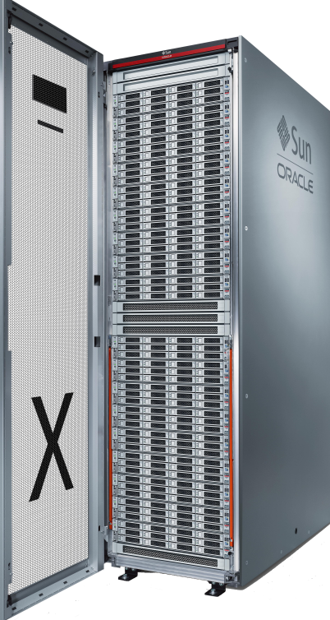
Exadata Database Machine X4-2 Full Rack
Pre-Configured for Extreme Performance
8 Xeon-based Dual-processor Database Servers
192 cores (24 per server)
2 TB memory expandable to 4 TB (256 GB per server expandable to 512GB)
10 Gig E-connectivity to Data Center
40 x 10Gb E-ports (5 per server)
14 Exadata Storage Servers X4-2
All with High Performance 12 x 1.2 TB SAS disks
OR
All with High Capacity 12 x 4 TB SAS disks
44.8 TB High Speed Flash
2 Sun Datacenter InfiniBand Switch 36
36-port Managed QDR (40Gb/s) switch
1 “Admin” Ethernet switch
Redundant Power Distributions Units (PDUs)

Slide 8
Exadata Storage Expansion X4-2 Full Rack
For additional storage – backups, historical data, unstructured data
18 Exadata Storage Servers X4-2
All with High Performance 12 x 1.2 TB SAS disks
OR
All with High Capacity 12 x 4 TB SAS disks
57.6 TB High Speed Flash
2 Sun Datacenter InfiniBand Switch 36
36-port Managed QDR (40Gb/s) switch
1 “Admin” Ethernet switch
Redundant Power Distributions Units (PDUs)
Add storage capacity to Database Machine online

Slide 9
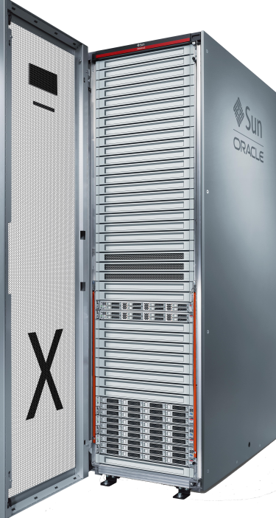
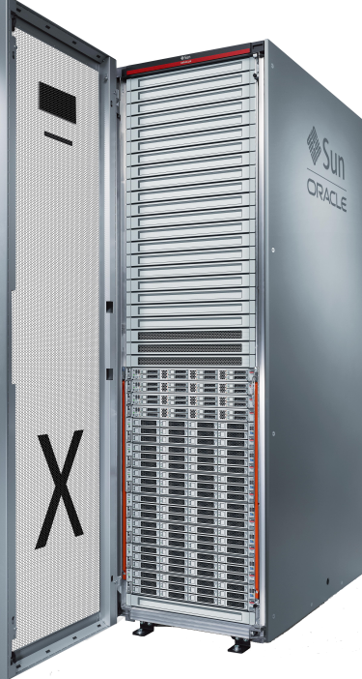
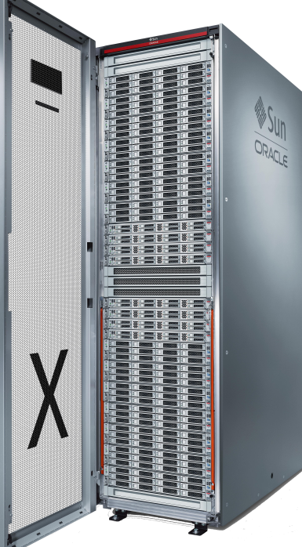
Start Small and Grow
Field Upgradeable
Eighth Rack
Quarter Rack
Half Rack
Full Rack
Unique Architecture Makes it Fastest at the Lowest Cost

Slide 10

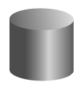
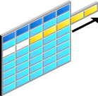

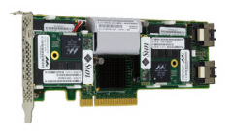
Key Exadata Innovations
Intelligent storage
Smart Scan query offload
Scale-out storage
Hybrid Columnar Compression
10x compression for warehouses
15x compression for archives
Data remains compressed for scans and in Flash
+
+
+
Uncompressed
Smart Flash Cache
Accelerates random I/O up to 30x
Doubles data scan rate
primary
backup
Benefits Multiply
test
standby
dev’t
Compressed

Slide 11
Oracle Exadata for Spatial Workloads
Oracle Spatial is particularly suitable for the Exadata architecture
CPU intensive geospatial calculations
Excellent use of parallelism
Load distribution between server nodes and storage heads
Index operations benefiting from large memory
Breaks new boundaries for ingesting spatial data
Using the fast I/O and high network bandwidth
Same architecture for Transaction Processing, Data Warehousing, Spatial Data Infrastructure, …

Slide 12
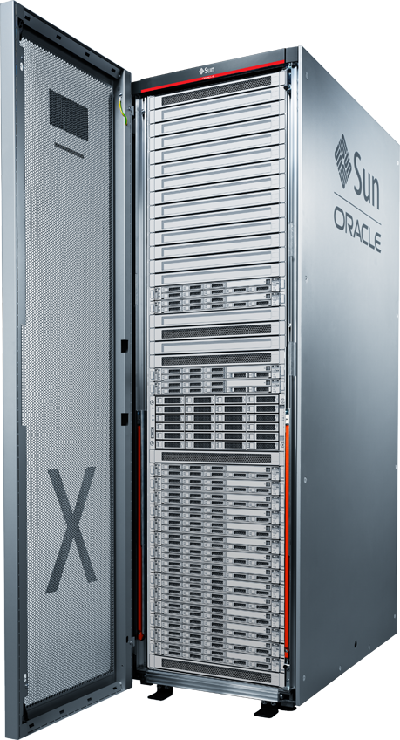
Part of Oracle Database Kernel
Code resides in Database Address Space
Index operations performed in Database SGA
Spatial operators are parallel enabled by default and execute in Database Address Space for maximum scalability
Seamlessly exploit Database security, compression, partitioning services
Notes:
Exadata Hybrid Columnar Compression of point data sets reduces storage required
Supports high speed inserts with 1.5x compression with spatial index enabled
Over 10x compression in high archive mode

Slide 13
High Performance Spatial Query and Index Operations
First filter brings approximate results into SGA; exact results performed in memory
Spatial operators performed in parallel against partitioned and non-partitioned data sets
Spatial query analysis up to 100x faster
Millions of spatial objects evaluated in minutes
Point in polygon analysis
Polygon to polygon analysis
Deviation from route
Distance covered

Slide 14
High Performance Database Load
Massive ingestion of Spatial data from sensors, weather data, satellites, and other streams by government environmental and analysis agencies
Millions of Spatial objects ingested in minutes
Weather readings
Traffic readings
Sensor readings

Slide 15
Best Practices
Spatial Index Creation Options
Exploiting Query parallelism
Pipelined Functions
Massive Ingestion of Spatial Data
Using Data Compression

Slide 16
<Insert Picture Here>
Spatial Indexing

Slide 17
Spatial Index Creation Options WORK_TABLESPACE
During spatial index creation, the process creates intermediate tables that get dropped when the index is complete.
The intermediate tables can take up to 2 times the size of the final index. If WORK_TABLESPACE is not specified, the intermediate tables are created in the same tablespace as the final index, causing fragmentation, and possible performance degradation.
You can use SDO_TUNE.ESTIMATE_RTREE_INDEX_SIZE, and multiply the result by 2 to provide guidance on sizing the work tablespace. The work tablespace can be re-used to create other spatial indexes.

Slide 18
Spatial Index Creation Options LAYER_GTYPE
This parameter is needed especially when working with point-only layers. If a point-only layer stores its points in the SDO_ORDINATE_ARRAY, you can still specify LAYER_GTYPE=POINT on spatial index creation.
This can help query performance when performing spatial analysis.

Slide 19
Spatial Index Creation Options SDO_NON_LEAF_TBL
This parameter is useful for very large spatial indexes
Splits the index in two tables instead of one.
The smaller spatial index table is the non-leaf table, which is traversed most often during spatial analysis.
It can be beneficial to pin the non-leaf table into the buffer pool, since it is accessed most often.
Non-Leaf Nodes
Single Index Table
Leaf Nodes

Slide 20
Spatial Index Creation Parameters SDO_NON_LEAF_TBL
Create the index, specifying a “non-leaf” table
Find the name of the “non-leaf” table
“Pin” it in memory
CREATE INDEX geod_counties_sidx ON geod_counties(geom) INDEXTYPE IS MDSYS.SPATIAL_INDEX PARAMETERS ('sdo_non_leaf_tbl=TRUE');
SELECT sdo_nl_index_table FROM user_sdo_index_metadata WHERE sdo_index_name='GEOD_COUNTIES_SIDX‘;
MDNT_A930$
ALTER TABLE MDNT_A930$ STORAGE(BUFFER_POOL KEEP)

Slide 21
<Insert Picture Here>
Parallel Processing

Slide 22
Parallel Processing Use Cases from Real-world Experiences
Re-Insurance Company
Risk management in a hurricane scenario
US Rail
Bulk nearest neighbor queries to find closest track, and project reported train positions onto tracks
Validate home appraisals for a Government Sponsored Enterprise (GSE)
Find all the parcels touching parcels to validate appraisals
Satellite Imagery Provider
Find all the useful portions of cloud covered imagery

Slide 23
1. Risk Management Requirements
A re-insurance company maintains portfolios for hundreds of insurance companies.
“Which properties will be (or are) affected by the projected path of a hurricane ?”
Data: 36 million rows, 64 partitions, each with about 571,000 rows.

Slide 24
Risk Management Parallel Spatial Query Against Partitioned Tables
Partition pruning occurs first.
Unmatched partitions are not searched
If a spatial operator’s query window spans multiple partitions, partitions are searched in parallel.
This is automatic for all spatial operators
Spatial Query
Partition 1
Partition 2
Partition K
Partition N-1
Partition N

Slide 25
Risk Management Query Syntax
Enable parallelism if not set on the tables
ALTER SESSION FORCE PARALLEL DDL PARALLEL 72;
ALTER SESSION FORCE PARALLEL QUERY PARALLEL 72;
SELECT p.property_id
FROM properties p,
hurricanes h
WHERE h.hurricane_name = 'Kurt'
AND sdo_within_distance (
p.property_geom, h.hurricane_track,
'distance=200 unit=meter'
) = 'TRUE';

Slide 26
Risk Management Results
Search completes in 50 seconds without parallelism
Completes in 1.28 seconds when run in parallel (on Half Rack Exadata V1 database machine with 48 cores)
That is almost 40 times faster!

Slide 27
2. US Rail Application Requirements
GPS locations for each train collected throughout the day
Each location has other attributes (time, speed, and more)
GPS locations have a degree of error, so they don’t always fall on a track.
Bulk nearest neighbour queries to find closest track, and project reported train positions onto tracks
Information used for:
Tracking trains
Analysis for maintenance, ensure engineers are within parameters, …

Slide 28
US Rail Application Parallel “CREATE TABLE AS SELECT” (CTAS)
Spatial operators parallelize “CTAS” when multiple candidates feed the second argument
Consider a set of 45,158,800 train positions recorded using the on-board GPS
For each train position:
Find the closest track to the train (with SDO_NN)
Then calculate the position on the track closest to the train

Slide 29
US Rail Application Query Syntax
ALTER SESSION FORCE PARALLEL DDL PARALLEL 72;
ALTER SESSION FORCE PARALLEL QUERY PARALLEL 72;
CREATE TABLE track_matches nologging PARALLEL AS
SELECT /*+ ordered index (t tracks_spatial_idx) */
p.locomotive_id, t.track_id, p.timestamp
sdo_lrs.find_measure (t.track_geom, p.locomotive_pos) measure
FROM positions p,
tracks t
WHERE sdo_nn (
t.track_geom, p.locomotive_pos, 'sdo_num_res=1'
) = 'TRUE';

Slide 30
US Rail Application Results
Compare serial vs. parallel “Exadata” runs
X2-2 Half Rack (serial execution): 34.75 hours
X2-2 Half Rack (48 database cores, parallel execution) : 41.1 minutes (47x faster)
X2-2 Full Rack (96 database cores) about 94x faster
X2-8 (128 cores) even faster …
Near-linear scalability
Serial executions on other hardware are slower than Exadata

Slide 31
US Rail Application Using Compression
EHCC (Exadata Hybrid Columnar Compression)
Can compress point geometries
12.03 GB vs. 1.125 GB with EHCC “Archive High” Compression
10.69x compression

Slide 32
US Rail Application Parallel “CREATE TABLE AS SELECT” (CTAS)
This technique works with all spatial operators!
SDO_ANYINTERACT
SDO_INSIDE
SDO_TOUCH
And also
SDO_WITHIN_DISTANCE
SDO_NN

Slide 33
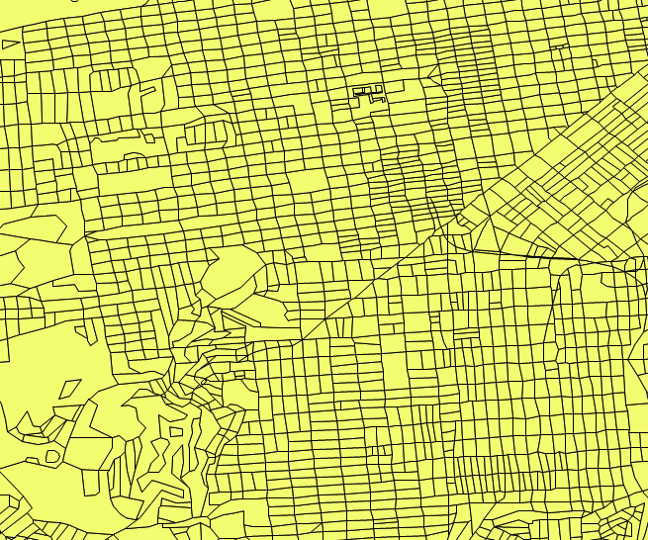
3. Validate Home Appraisals Requirements
Validate home appraisals for a Government Sponsored Enterprise (GSE)
Find all the parcels touching parcels to validate appraisals

Slide 34
Validate Home Appraisals Parallelized Spatial Join (SDO_JOIN)
Effective way to compare all geometries in one layer to all geometries in another (or most to most)
Leverages spatial index for both spatial layers
Can be orders of magnitude faster than a regular spatial operator (SDO_TOUCH etc)
Additional coding to force parallelism

Slide 35
Validate Home Appraisals Using SDO_JOIN ?
SELECT p1.parcel_id, p2.parcel_id
FROM TABLE (
SDO_JOIN (
'PARCELS', 'GEOM',
'PARCELS', 'GEOM',
'mask=touch‘
)
) j,
parcels p1,
parcels p2
WHERE j.rowid1 = p1.rowid
AND j.rowid2 = p2.rowid
AND j.rowid1 > j.rowid2;
SDO_JOIN returns an array of objects with ROWID pairs
TABLE() makes that result look like a regular table
Join the result with the ROWIDs of the spatial tables involved
BUT: PARALLELISM
IS NOT USED!

Slide 36
Validate Home Appraisals How to use Parallelism with SDO_JOIN
First, capture the approximate matches
CREATE TABLE parcel_matches_filter AS
SELECT rowid1, rowid2
FROM TABLE (
SDO_JOIN (
'PARCELS', 'GEOM',
'PARCELS', 'GEOM'
)
)
WHERE rowid1 > rowid2;
Primary filter only, very effectively utilizes the spatial index of parcel polygons
Returns rowid pairs that likely touch

Slide 37
Validate Home Appraisals How to use Parallelism with SDO_JOIN
Then determine true relationship using the SDO_GEOM.RELATE() function.
Parallelize calls to the spatial function.
CREATE TABLE parcel_matches NOLOGGING PARALLEL AS
SELECT /*+ ordered use_nl (m,p1) use_nl (m,p2) */
sdo_geom.relate (
p1.geom, 'DETERMINE', p2.geom, .05
) relation,
p1.parcel_id, p2.parcel_id
FROM parcel_matches_filter m , parcels p1, parcels p2
WHERE m.rowid1 = p1.rowid
AND m.rowid2 = p2.rowid;

Slide 38
Validate Home Appraisals Results
Find all the parcels touching parcels to validate appraisals
Processed 2,018,429 parcels serially in 38.25 minutes
Exadata Half Rack (48 cores) – 50 seconds, 45x faster
X2-2 Full Rack (96 cores) – about 90x faster
X2-8 (128 cores) even faster …

Slide 39
SDO_JOIN – When is it Most Effective? Matching Points and Polygons
When not many geometries are associated with each polygon, SDO_JOIN is generally more effective
When many geometries are associated with each polygon, SDO_ANYINTERACT may be more effective
SDO_ANYINTERACT performs interior optimizations

Slide 40
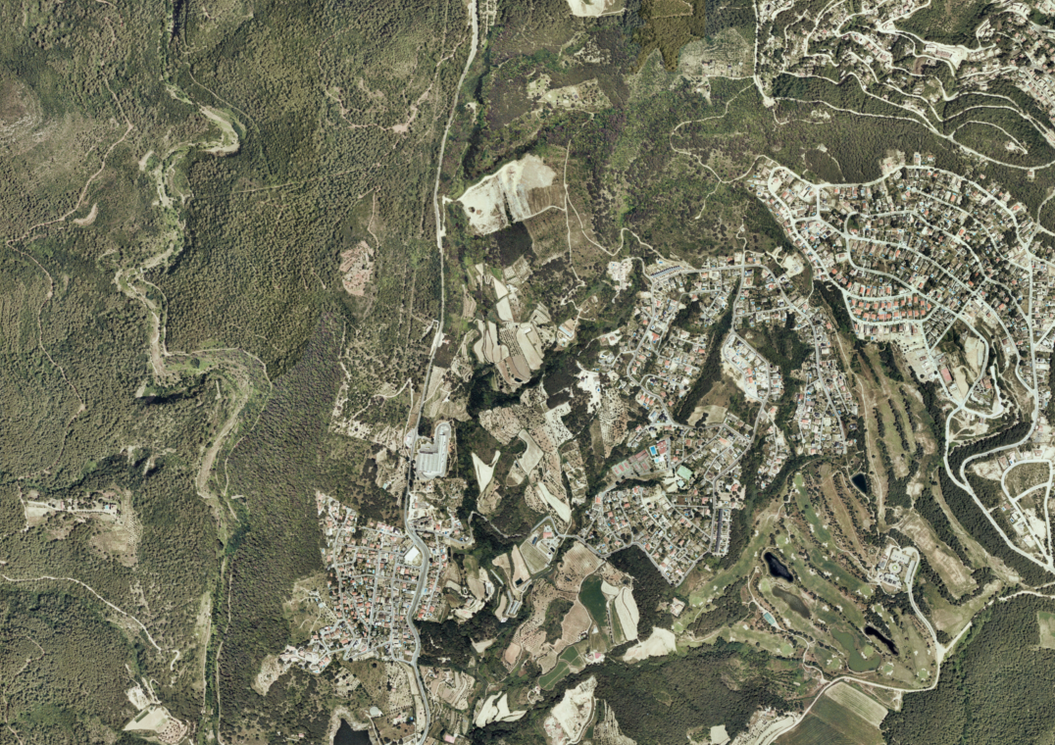
4. Satellite Imagery Provider Requirements
Find all the useful portions of cloud covered imagery
850,000 strip images
58,000,000 cloud cover geometries

Slide 41
Satellite Imagery Provider Parallelized Spatial Join (SDO_JOIN)
Effective way to compare all geometries in one layer to all geometries in another (or most to most)
Leverages spatial index for both spatial layers
Can be orders of magnitude faster than a regular spatial operator (SDO_TOUCH etc)
Additional coding to force parallelism

Slide 42
Satellite Imagery Provider Results
45 days to 4 days (non-Exadata with hardware constraints)
Convert from regular SDO_ANYINTERACT to SDO_JOIN
Apply parallelism
Optimize intersection calculations
From 4 days to hours or minutes on Exadata
Benefit from the large number of cores

Slide 43
Satellite Imagery Provider How did we do it ?
CREATE TABLE image_matches_filter AS
SELECT rowid1, rowid2
FROM TABLE (
SDO_JOIN (
'IMAGES', 'GEOM',
'COVERS', 'GEOM'
)
);
Stage 1
CREATE TABLE image_matches_compare NOLOGGING PARALLEL AS
SELECT /*+ ordered use_nl (m,i) use_nl (m,c) */
i.image_id, c.cover_id,
i.geom image_geom, c.geom cover_geom
sdo_geom.relate (
i.geom, 'DETERMINE', c.geom, .05
) relation
FROM image_matches_filter m , images i, covers c
WHERE m.rowid1 = i.rowid
AND m.rowid2 = c.rowid;
Stage 2

Slide 44
Satellite Imagery Provider Computing Intersections
Cover zone (in black) CONTAINS the image polygon
Intersection is the image polygon!
Cover zone (in black) is INSIDE the image polygon
Intersection is the cover zone!

Slide 45
Satellite Imagery Provider Only compute intersections when necessary
Relationship (A r B) | Matches | Intersection ?
OVERLAPBDYINTERSECT | 1 943 738 | Compute A intersect B
OVERLAPBDYDISJOINT | 366 | Compute A intersect B
COVERS | 64 | B
CONTAINS | 2 592 223 | B
TOUCH | 106 | NULL (no intersection)
DISJOINT | 624 854 | NULL (no intersection)
COVEREDBY | 6 | A
INSIDE | 661 298 | A

Slide 46
Satellite Imagery Provider How did we do it ?
﻿CREATE TABLE image_matches NOLOGGING PARALLEL AS
SELECT image_id,
cover_id,
relation,
case
when relation in ('COVERS', 'CONTAINS')
then cover_geom
when relation in ('COVEREDBY', 'INSIDE')
then image_geom
else
sdo_geom.sdo_intersection (image_geom, cover_geom, 0.05)
end intersection_geom
FROM image_matches_compare
WHERE relation not in ('TOUCH', 'DISJOINT');
Stage 3

Slide 47
<Insert Picture Here>
Pipelined Table Functions

Slide 48
Parallel-Enabled Pipelined Table Function
Parallelize a function that’s called a massive amount of times.
Batch geocoding (sdo_gcdr.geocode_address)
Batch reverse geocoding (sdo_gcdr.reverse_geocode)
Batch Digital Elevation Model (DEM) raster lookups (sdo_geor.get_cell_value)
Pipeline Table Function returns a table of results
Table of geocodes
Table of reverse geocodes
Table of elevation values

Slide 49
What is a “pipelined” function ?
Input to the pipelined function is a cursor
Can pass any SELECT statement when executed using a CURSOR expression
Output is a table
Cast as a regular relational table using the TABLE() construct.
Can feed the result into a table
Data flows continuously from input to output
Pipelined Function
CURSOR ( SELECT … FROM …)
TABLE (…)
INSERT INTO ...
SELECT ...
FROM TABLE (pipelined_function (CURSOR (SELECT ... from input_table) ) );

Slide 50
Inside the Pipelined Function
Declare the table type returned by the function
Function header
Function is declared as PIPELINED and PARALLEL_ENABLE
CREATE OR REPLACE TYPE sdo_geo_addr_table_type AS TABLE OF sdo_geo_addr;
/
CREATE OR REPLACE function reverse_gc (source_table_cursor IN SYS_REFCURSOR)
RETURN sdo_geo_addr_table_type
DETERMINISTIC
PIPELINED
PARALLEL_ENABLE (PARTITION source_table_cursor BY ANY)
IS

Slide 51
Inside the Pipelined Function
Variable declarations
IS
TYPE num_array_type IS TABLE OF NUMBER;
id_table NUM_ARRAY_TYPE;
geometry_table SDO_GEOMETRY_ARRAY;
geo_addr SDO_GEO_ADDR;
Use BULK COLLECT to fetch in batches into memory arrays
BEGIN
LOOP
FETCH source_table_cursor
BULK COLLECT INTO id_table, geometry_table LIMIT 100;
EXIT WHEN id_table.count = 0;
FOR i IN id_table.first .. id_table.last LOOP
geo_addr := SDO_GCDR.REVERSE_GEOCODE('NAVTEQ_SF', geometry_table(i), 'US');
geo_addr.id := id_table(i);
PIPE ROW (geo_addr);
END LOOP;
END LOOP;
CLOSE source_table_cursor;
RETURN;
END;
Process the arrays and use PIPE ROW to pass the output to the caller.

Slide 52
Control the Degree of Parallelism
Parallel Query distributes the batch process over a specified number of database cores.
Exadata ¼ rack has 2 nodes, each with 12 cores (24 cores total)
Distribute load serially on the 2 nodes:
Maximize use: distribute according to the load of each node:
ALTER SESSION FORCE PARALLEL DDL PARALLEL 24;
ALTER SESSION FORCE PARALLEL QUERY PARALLEL 24;
ALTER SESSION SET "_parallel_load_balancing"=FALSE;
ALTER SESSION FORCE PARALLEL DDL PARALLEL 48;
ALTER SESSION FORCE PARALLEL QUERY PARALLEL 48;
ALTER SESSION SET "_parallel_load_balancing"=TRUE;

Slide 53
Use the Function Example: geocoding function
Create a table to hold the result from the geocoding
Call the pipelined function for each address to be processed and write the result into that table.
CREATE TABLE results (id NUMBER, geom SDO_GEOMETRY);
INSERT /*+ append */ INTO results
SELECT id,
sdo_geometry (2001, 8307,sdo_point_type(longitude,latitude,null),null,null)
FROM TABLE (
geocode_pipelined (
CURSOR(
SELECT id, streetname, city, state, zip, housenum
FROM address_table
)
)
);

Slide 54
Results
Using Exadata ¼ RAC (24 Cores)
Batch geocoding – 1365/second
Batch reverse geocoding – 3388/second
Batch DEM get_cell_value raster lookups – 8951/second

Slide 55
Other Benchmarks Performed
Requirement: compare thousands of vector points to a DEM and other rasters to get cell values for each point
Vector points are tractor positions on farms (about 50,000 positions per farm)
Test for 36881 GPS points against a projected raster (i.e. includes coordinate transformations)
At parallel 24 we do 36881/5.4 = 6829 lookups per second
Parallel Degree | Elapsed
1 | 03:22.82
2 | 00:55.40
4 | 00:27.16
8 | 00:13.61
12 | 00:09.20
24 | 00:05.40

Slide 56
Other Benchmarks Performed
Requirement: geocoding addresses in batch
Tests performed on “regular” hardware
Intel Xeon CPU X5670 @ 2.93GHz
1 CPU, Quad-core, 8GB RAM
Geocoded 65536 addresses in 5 1/2 minutes
We will repeat full tests on an Exadata with more parallelism.
Parallel Degree | Geocodes / sec
1 | 47
4 | 189
Parallel Degree | Geocodes / sec
24 | 1365

Slide 57
<Insert Picture Here>
Data Ingestion

Slide 58
Massive Data Ingestion Requirements
For OLTP applications that need to insert into tables with the spatial index enabled
Vehicle tracking
Weather updates
…

Slide 59
Massive Spatial Data Ingest
Two types of requirements:
Data does not need to be “online” immediately
Load new batch into a “staging table” without indexes
Create spatial and non spatial indexes on the staging table
Exchange staging table into an existing partitioned table.
Data should be “online” quickly
No time for a staging table
Load directly into live table
Different strategies for the two types of requirements.
Both requirements require data modeling considerations

Slide 60
Massive Spatial Data Ingest With a Staging Table
Major benefits are performance and manageability of very large data sets
Example requirement:
Ingest and maintain 2 days of weather data online
270,000 new samples every 30 seconds
Implemented with:
30-second partitions (5760 partitions over 2 days)
New partitions rolled on, older partitions rolled off

Slide 61
Massive Spatial Data Ingest With a Staging Table
Load data into a staging table without any indexes.
Create all indexes (spatial index too) on the staging table
Partition P1 is an empty leading partition
Swap partition P1 with the staging table
Update partitioned table with new weather data in a fraction of a second.
No need to maintain an index on INSERT !!!!
ALTER TABLE weather_data_part
EXCHANGE PARTITION p1 WITH TABLE weather_data_batch
INCLUDING INDEXES
WITHOUT VALIDATION;

Slide 62
Massive Spatial Data Ingest Without a Staging Table
Spatial data must be inserted and committed immediately
No time for a staging table.
If possible, don’t commit after every insert.
If possible, perform batch inserts.
Set SDO_DML_BATCH_SIZE =15000 when you create the spatial index.
PL/SQL - FORALL BULK INSERTS
Java - JDBC UPDATE BATCHING
C – Array inserts

Slide 63
Massive Spatial Data Ingest Without a Staging Table
Common Misconception:
Only true if connections in pool write to different spatial indexes.
For high ingest rates, even two connections writing to the same spatial index can adversely affect spatial index ingest performance due to index contention!
Use multiple indexes (= multiple partitions)
"Increasing the number of connections in a pool, and the number of threads performing inserts will increase spatial data insert throughput”

Slide 64
Massive Spatial Data Ingest Without a Staging Table
Simple solution:
Stream all writes to one connection in the pool.
One connection for writes
Many connections for reads
Better solution:
Use multiple connections in a connection pool
Dedicate each connection to one spatial index (= one partition)
This eliminates all spatial index contention.

Slide 65
Massive Data Ingestion Divide and Conquer
Each insertion process writes to a separate partition
Partition table by time and process id (composite partition key)
Assign process id’s to Java pool connections
Each connection only writes to the partition with the same process id
Eliminates index contention
Partitioning is transparent to application developer.
Queries are written against one table,
Oracle manages which partitions to search.

Slide 66
Massive Data Ingestion Using a Partitioned Table
Partition by hour (or minute, or 15 minutes)
CREATE TABLE composite_example ( t timestamp, process_id number, geom sdo_geometry, hour_partition as (substr(t,1,12))
) PARTITION BY RANGE (hour_partition, process_id) ( PARTITION DAY1_H5_1 VALUES LESS THAN ('30-NOV-10 05',2), PARTITION DAY1_H5_2 VALUES LESS THAN ('30-NOV-10 05',3), PARTITION DAY1_H5_3 VALUES LESS THAN ('30-NOV-10 05',4), PARTITION DAY1_H6_1 VALUES LESS THAN ('30-NOV-10 06',2), PARTITION DAY1_H6_2 VALUES LESS THAN ('30-NOV-10 06',3), PARTITION DAY1_H6_3 VALUES LESS THAN ('30-NOV-10 06',4), PARTITION REST VALUES LESS THAN (MAXVALUE,MAXVALUE)
);

Slide 67
Massive Data Ingestion Batch Updating
Batch inserts are critical for performance:
“FORALL” bulk inserts (if PL/SQL) …
JDBC Update Batching (if Java)
Set SDO_DML_BATCH_SIZE = 15000 (this really helps)
Benchmark commits every 15000 inserts
Commit after inserting a number of objects (>= SDO_DML_BATCH_SIZE)
Reduces the overhead from each insert
Improves index quality
Reduces redo and undo logging

Slide 68
Massive Data Ingestion Benchmark Results
Parallel Degree | Inserts/Sec (100k/15k) | Inserts/Sec (1m/15k)
1 | 3 901,92 | 3 701,10
2 | 7 646,74 | 7 352,68
8 | 30 757,95 | 28 870,05
12 | 44 843,68 | 41 557,92
8x2 | 59 547,36 | 50 237,07
12x2 | 84 309,38 | 66 123,57
Parallel Degree: how many processes are running in parallel
8x2 means 16 processes, 8 running on node 1 and 8 on node 2
Inserts/Sec: how many rows are inserted every second by all processes
1m/15k means each process inserts 1,000,000 rows and commits every 15000 rows.

Slide 69
Massive Data Ingestion Benchmark
90,000
80,000
Results
70,000
60,000
Inserts
Per Second
50,000
(100k/15k)
40,000
Inserts/Sec (1m/15k) w/o patch
30,000
(1m/15k)
20,000
10,000
0
1
2
8
12
8x2
12x2
Number Of Cores

Slide 70
<Insert Picture Here>
Data Compression

Slide 71
Database Compression
Exadata Hybrid Columnar Compression
Reduces storage required for vector data sets
Over 10x compression in high archive mode
SecureFile LOB Compression or GeoRaster DEFLATE
Reduces storage required for Raster data sets
For Gridded data sets: 5 to 100x compression (data dependent)
For DEMs and Images: ~1.5x compression
GeoRaster JPEG-F Compression
2 - 15x compression lossy

Slide 72
Exadata Hybrid Columnar Compression
Point, Line and Polygon geometries can all benefit from EHCC
Lines and Polygons: must be stored inline (less than 4K in size).
Options include:
COMPRESS FOR QUERY LOW
COMPRESS FOR QUERY HIGH
COMPRESS FOR ARCHIVE LOW
COMPRESS FOR ARCHIVE HIGH
Will increase the cost of fetching the geometries!

Slide 73
Using Compressed Tables
Specify compression when creating tables
Can create and populate from existing table
Or use an insert loop in “direct-path” mode
CREATE TABLE edges_compressed
COMPRESS FOR QUERY LOW;
CREATE TABLE edges_compressed
COMPRESS FOR QUERY LOW NOLOGGING
AS
SELECT * FROM edges;
INSERT /*+ append_values */
INTO edge_compressed VALUES (...);

Slide 74
Spatial Queries on Compressed Tables Point Data
Within_distance Query | Uncompressed | Query Low 3.5x | Query High 5.3x | Archive High 6.8x
4 mile (323 rows) | 0.02 sec | 0.02 sec (0.0x) | 0.06 sec (3.0x) | 1.36 sec (68x)
5 mile (1251 rows) | 0.03 sec | 0.06 sec (2.0x) | 0.12 sec (4.0x) | 2.77 sec (92x)
10 mile (31466 rows) | 0.29 sec | 0.61 sec (2.1x) | 1.3 sec (4.5x) | 32.11 sec (110x)

Slide 75
Spatial Queries on Compressed Tables Line Data
Within_distance Query (lines) | Uncompressed | Query Low 3.5x | Query High 5.3x
4 mile (809 rows) | 0.25 sec | 0.75 sec (3.0x) | 2.35 sec (9.4x)
5 mile (3079 rows) | 0.65 sec | 2.02 sec (3.1x) | 6.00 sec (9.2x)
10 mile (80771 rows) | 2.93 sec | 8.69 sec (2.9x) | 26.0 sec (8.97x)

